Slide 1

3D Object Clouds: Viewing Virtual Objects in Interactive Clouds on Mobile Devices
Xiaoting Hong
Examining Committee
Dr. Stephen Brooks (Supervisor)
Dr. Bonnie Mackay (Reader)
Dr. Kirstie Hawkey (Reader)
Dr. Dirk Arnold (Chair)

Slide 2
Outlines
Introduction
Viewing 3D Objects in Interactive Clouds on Mobile Device
User Studies
Conclusions and Discussions

Slide 3
Introduction

Slide 4
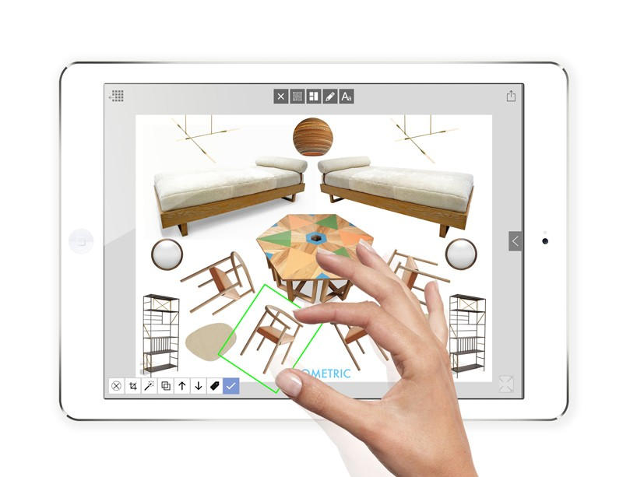
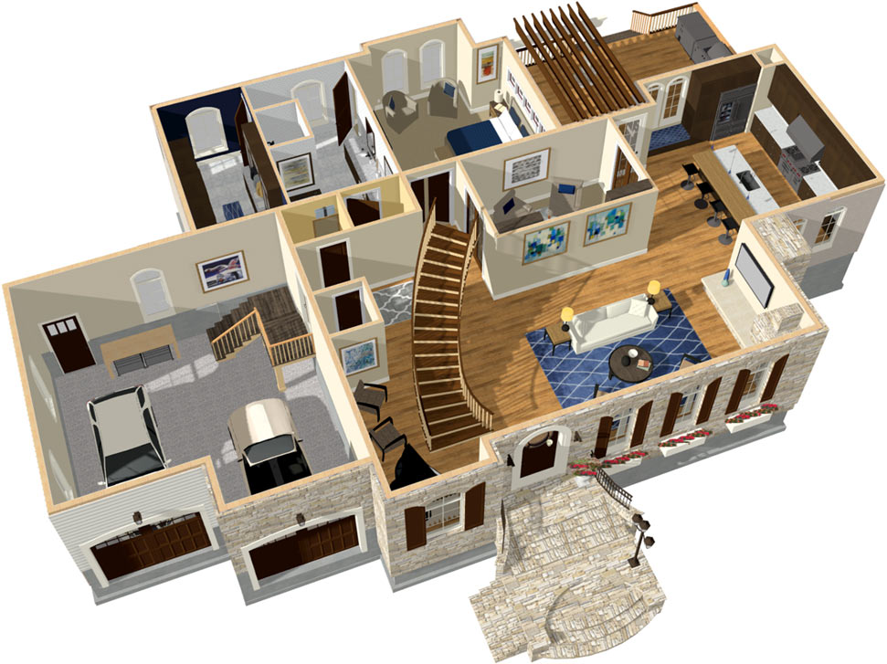
Create your virtual home
http://www.designboom.com/wp-content/uploads/2015/11/morpholio-trace-board-applications-ipad-pro-designboom-10-818x613.jpg
https://cloud-hd.chiefarchitect.com/1/images/general/doll-house-full.jpg

Slide 5
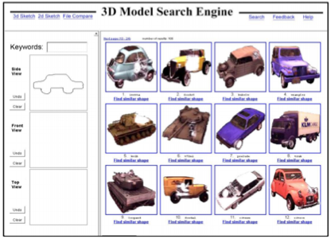
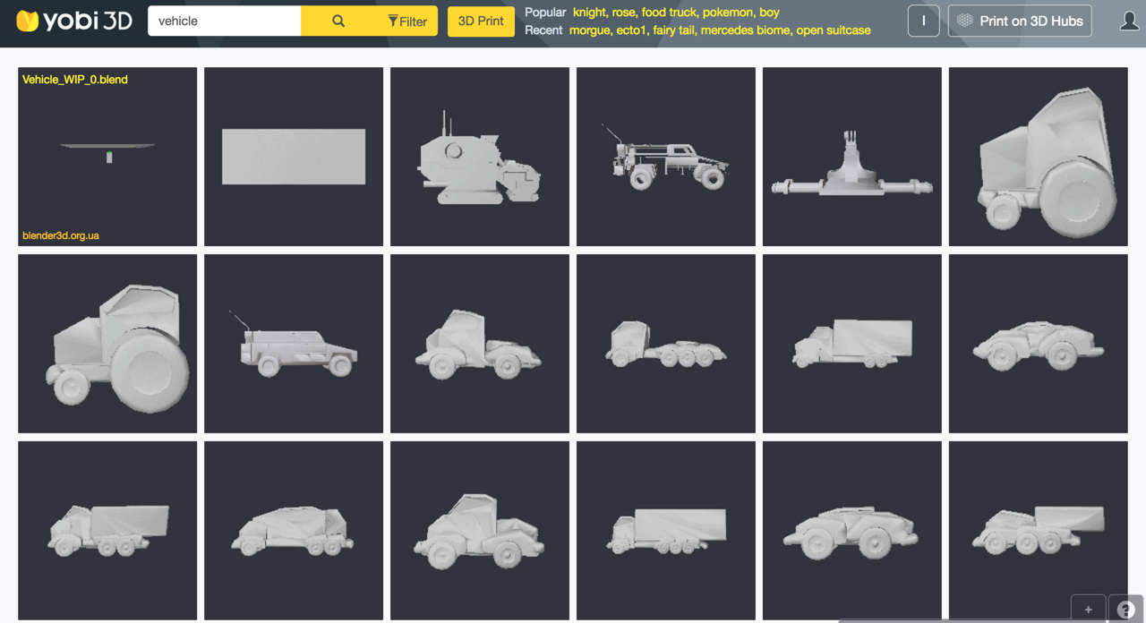
Background and Motivation
“Find” rather than “Create”
Browsing & searching 3D object datasets approaches
Academic: Shape-based search engine for 3D models
Commercial: online browsing, game engine assets, etc.
Image resource:
https://www.yobi3d.com/#!/search?q=vehicle
T. Funkhouser et al., "A Search Engine for 3D Models," ACM Transactions on Graphics (TOG), vol. 22, no. 1, pp. 83-105, January 2003.

Slide 6
Research Questions
How to better organize a set of 3D objects for comparison and recognition?
How to best organize the collection of 3D objects within limited screen space?
What features should be chosen to give weight to the importance of objects & form patterns?
How to maximize the valid information for 3D objects?

Slide 7
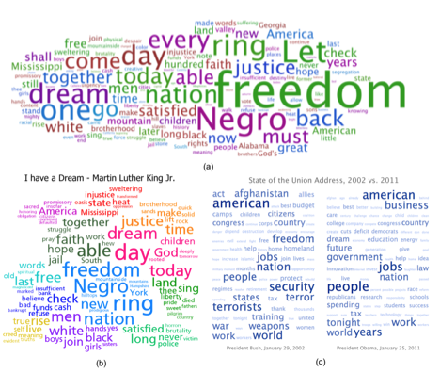
Tag Clouds

Slide 8
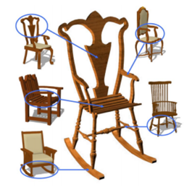
3D Model Applications

Slide 9
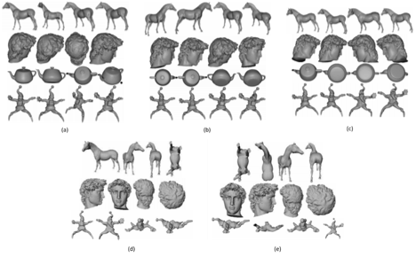
Canonical Views
Four top-ranking views among candidate views generated by algorithms (a) to (f): surface area entropy, ratio of visible area, curvature entropy, silhouette length, and silhouette entropy [10].

Slide 10
Research Questions and Objectives
How to better organize a set of 3D objects for comparison and recognition?
How to best organize the collection of 3D objects within limited screen space?
Cloud View
What features should be chosen to give weight to the importance of objects & form patterns?
Shape
How to maximize the valid information for 3D objects?
Canonical Views

Slide 11
Our Approach:
Viewing 3D Objects in Interactive Clouds on Mobile Devices

Slide 12
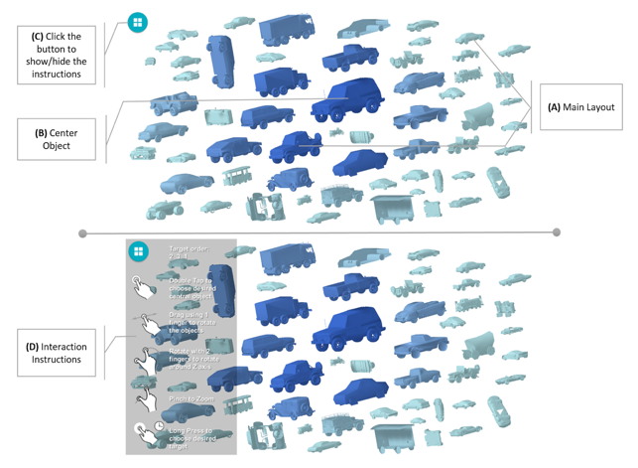
System Interface
Design
Crawl through the space of objects with simple gestures
Maximize the valid information
Vary the colors and sizes

Slide 13
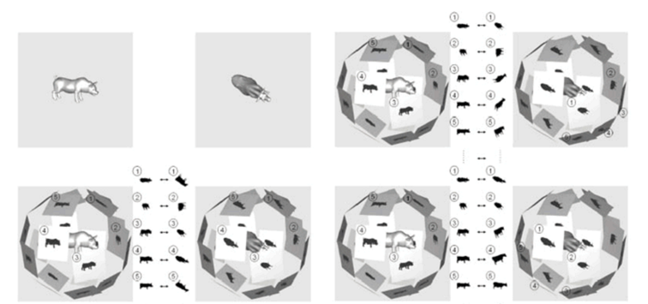
Object Similarity
Applied visual similarity approach proposed by D.Chen et. al [4] between 3D objects in the preprocessing stage
“If two 3D models are similar, they look similar from all viewing angles”
A set of Lightfield Descriptors for a 3D object [4].

Slide 14
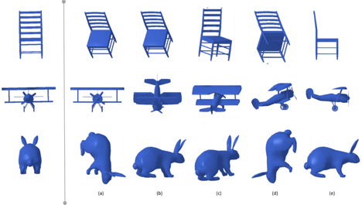
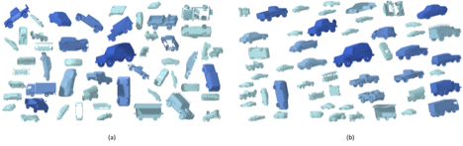
Canonical Views
Canonical View Selection Algorithms:
(a) surface area entropy [11];
(b) view area [9];
(c) silhouette length [10];
(d) silhouette entropy [12];
(e) mesh saliency [24].
The packing layouts without parallel (a) and with parallel (b)

Slide 15
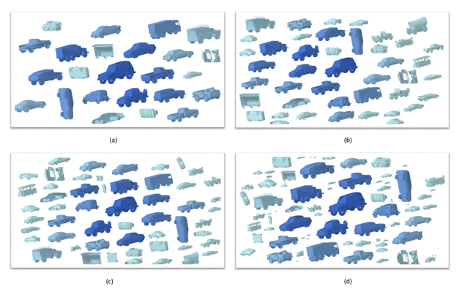
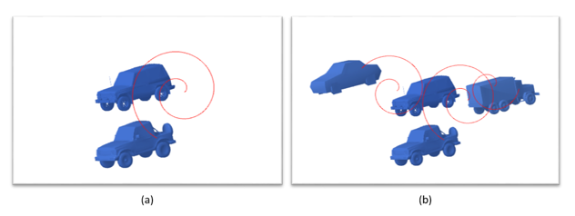
Packing Layout Design
The layouts with different values of grid numbers (M). (a) M = 10; (b) M = 30; (c) M = 50; (d) M = 70.
An example of moving objects along spirals: (a) One object moves along a spiral path to find its final position around the center object in this layout; (b) Three objects move along spiral paths respectively.

Slide 16
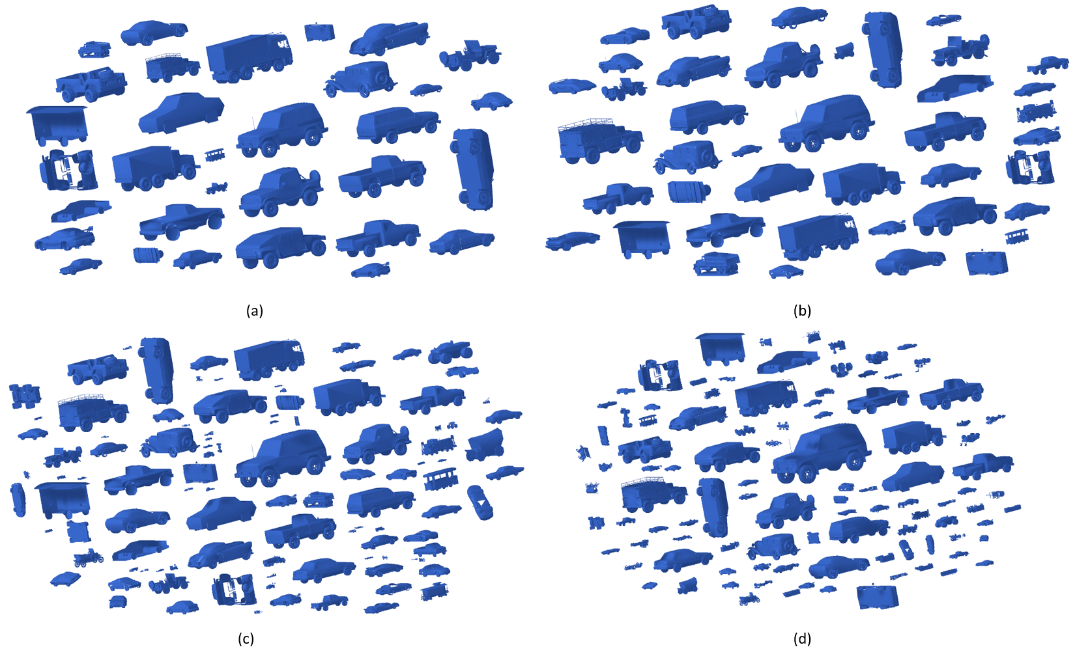
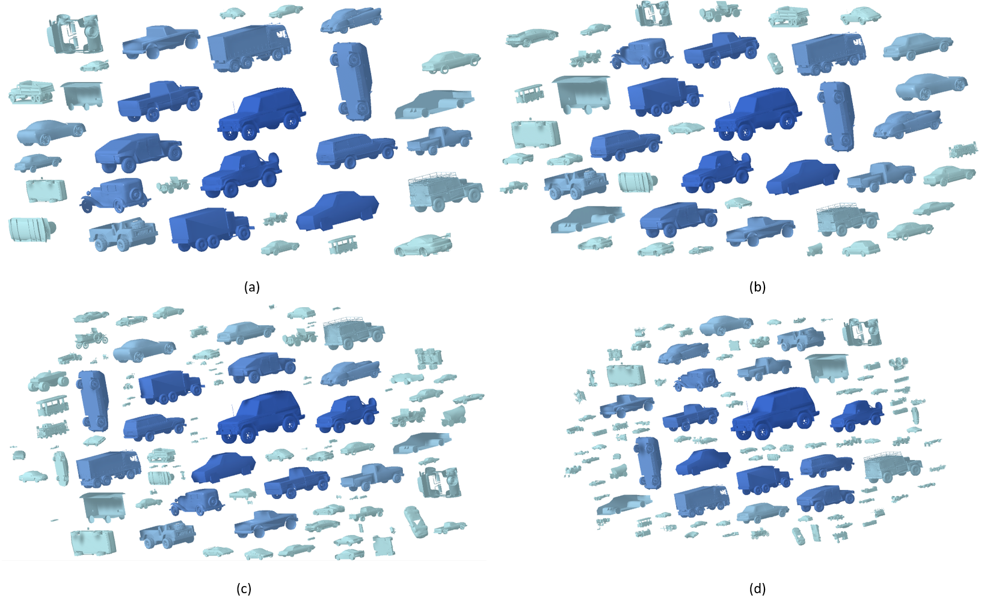
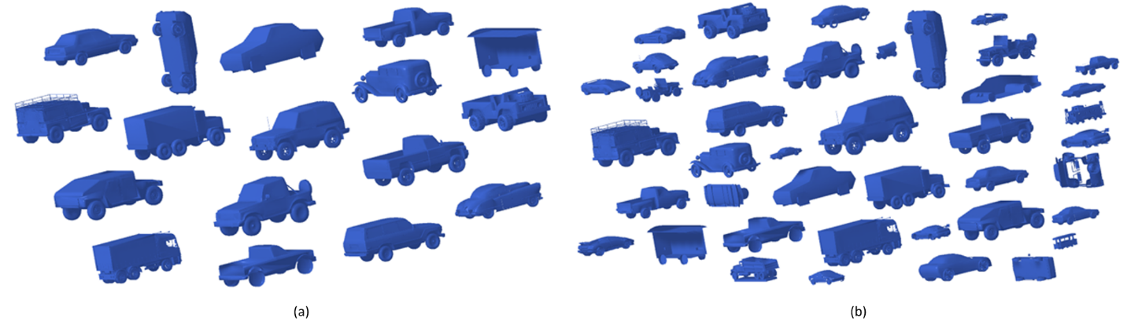
Vary Sizes and Colors
The example of layouts after being enforced color-tone feature
The example of layouts with different size decrease ratio for their initial sizes: (a) decrease ratio = 0.1; (b) ratio = 0.2; (c) ratio = 0.3; (d) ratio = 0.4
The layouts with applied varying size feature (b) and without (a)
Notes:
To stress the underlying similarity pattern of the layout, first of all, we decided to vary the sizes of packed objects according to their similarity levels with the center object. In other words, the more similar the object is with the center object, the bigger the object’s size.
Secondly, we combine the varying-color feature with the above size principle. The varying-color feature, similarly, means that the similar with the center, the color of the object will be more opaque, and vice versa.

Slide 17
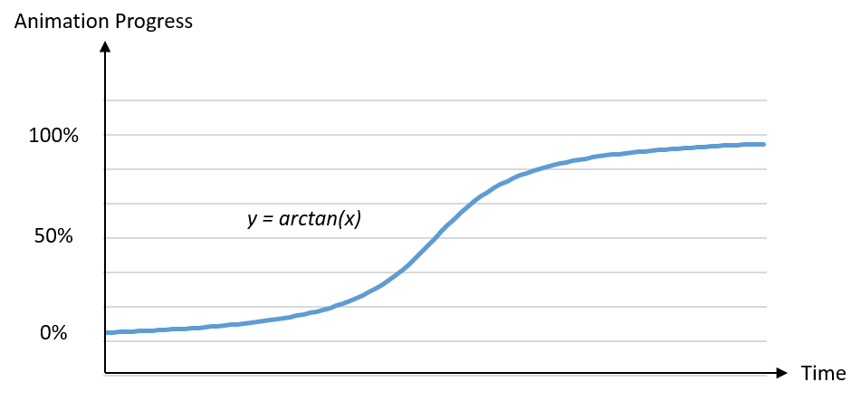
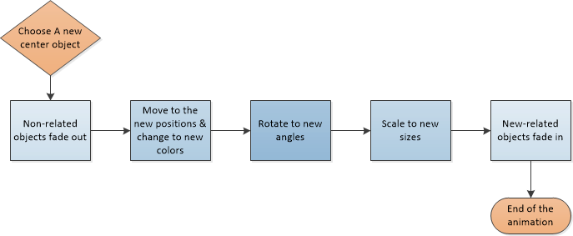
Staggered Animation
Staggered Animation Procedure Diagram
A schema of the slow-in, slow-out timing
Notes:
because most of movements occur in the middle third of the animation duration.

Slide 18
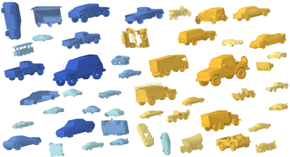
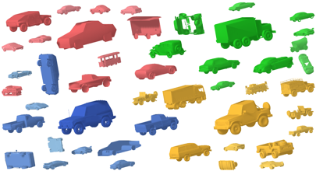
Additional Features
Multi-group Packing Layouts
Switching Canonical Views

Slide 19
User Study

Slide 20
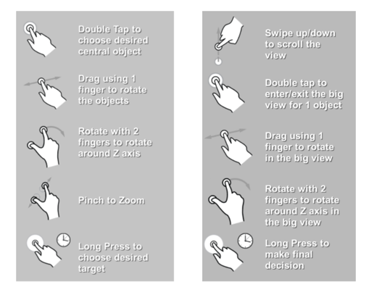
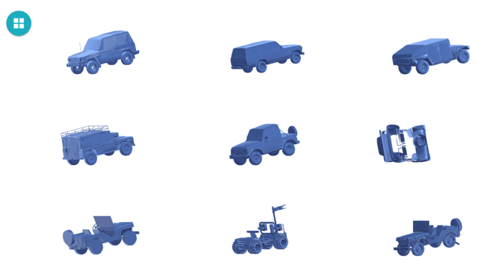
User Study 1

Slide 21
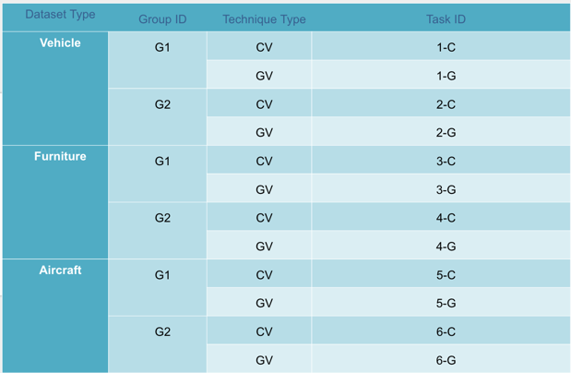
Study Design
2 X 3 within-subject design
2 Techniques
CV vs. GV
3 Types of Datasets
Furniture, Vehicle and Aircraft
2 Different Task Groups
48 Participants
Total: 144 Cases
Notes:
The number of objects in the datasets furniture, vehicle, and aircraft is 198, 103, and 216 respectively. With the observations in both the pilot and the formal experiment, we suggest that the complexity of datasets in this experiment has the relation: 𝐶𝑜𝑚𝑝𝑙𝑒𝑥𝑖𝑡𝑦 𝑓𝑢𝑟𝑛𝑖𝑡𝑢𝑟𝑒 < 𝐶𝑜𝑚𝑝𝑙𝑖𝑥𝑖𝑡𝑦 𝑣𝑒ℎ𝑖𝑐𝑙𝑒 < 𝐶𝑜𝑚𝑝𝑙𝑒𝑥𝑖𝑡𝑦 𝑎𝑖𝑟𝑐𝑟𝑎𝑓𝑡. We also suggest the reason that the cause of this difference is the similarity between the objects.
The first study involves 48 participants

Slide 22
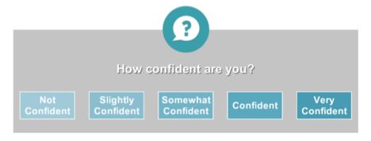
Study Factors
Independent Variables
Techniques:
CV (cloud-based technique)
GV (grid-based technique)
Datasets with three types:
furniture (amount of objects is 198)
vehicle (amount of objects is 103)
aircraft (amount of objects is 216)
Dependent Variables
Time of finishing tasks
Number of times choosing the wrong targets
Confidence level of making decisions
Notes:
By conducting a user study, we want to test the following research hypotheses:
• The cloud view based (CV) approach is more efficient for the specific searching than the grid view based (GV) approach;
• The cloud view based (CV) approach is easier for comparing the similarity and differences between the objects and the targets than the grid view based (GV) approach;
• The cloud view based (CV) approach is more interesting/attractive to use compared to the grid view based (GV) approach;

Slide 23
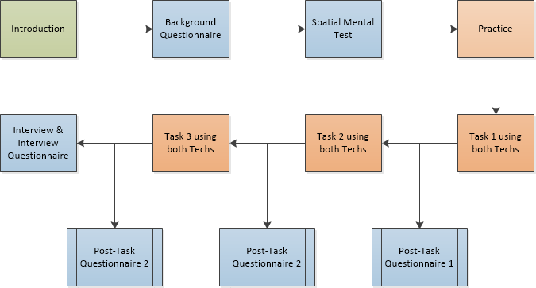
General Procedure

Slide 24
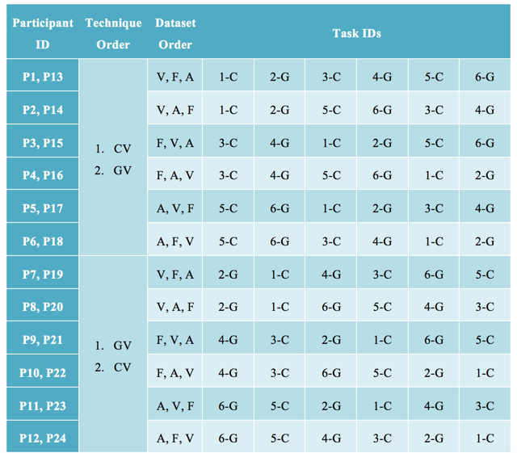
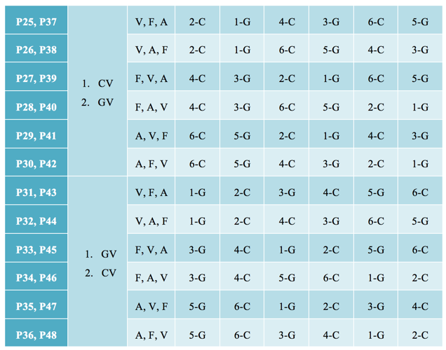
Task Arrangement
Notes:
For the purpose of counterbalancing the conditions in the experiment, we made full permutations of the dependent factors (2 techniques) and the potential influence factors (3 types of datasets, and 2 different object groups),
and we fully randomized the order of finding the objects within each object group. Hence, we need 2! * 3! * 2! = 24 participants to fully conduct all cases, and we repeated every case twice which leads to 24 * 2 = 48 participants and 48 * 3 𝑠𝑢𝑏𝑡𝑎𝑠𝑘𝑠 = 144 𝑐𝑎𝑠𝑒𝑠.
We decided to fully randomized the order of finding three objects because it would require 168 participants to achieve a full permutation which could be infeasible.

Slide 25
Study Results

Slide 26
Overview
Summary table of main effects for each of independent factors (N.S. = Not Significant and S. = Significant)
Dependent Factors | Independent factors
 | Technique | Type of Datasets
Task Finishing Time | S. | S.
Number of Wrong Choices | S. | N.S.
Level of Confidence | N.S. | S.

Slide 27
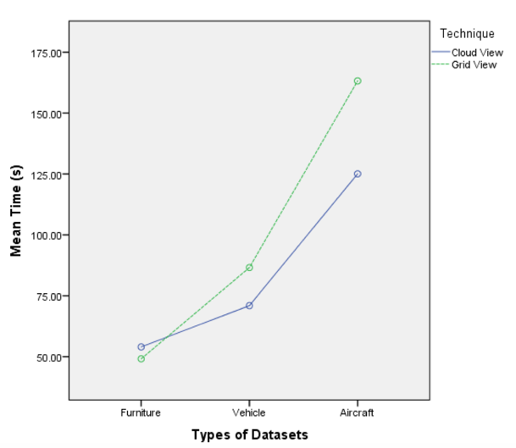
Task Finishing Time
Interactions were found to be significant
2 independent factors are significant
The more complicated the dataset, the longer the finishing time
CV enables subjects to finish tasks faster
This advantage increases when the complexity of datasets increases

Slide 28
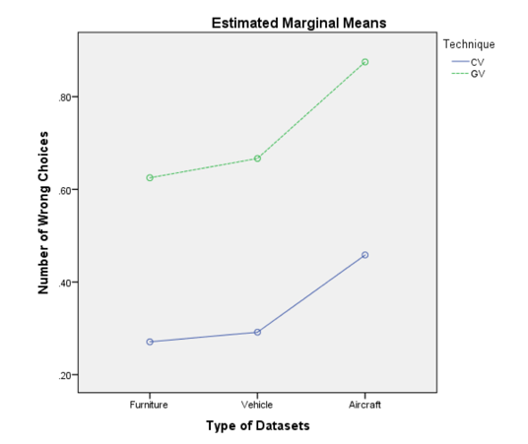
Number of Wrong Choices
Interactions were not significant
Technique factor was significant
Type of datasets factor is not significant
CV technique leads to less wrong choices on all three datasets

Slide 29
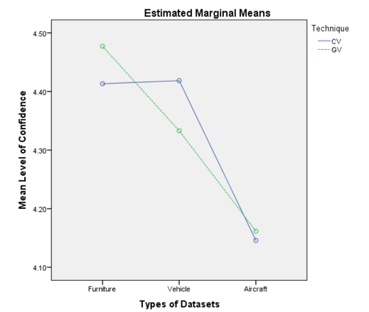
Level of Confidence
Interactions were not significant
Technique factor was not significant
Type of datasets factor is significant
Average confidence level of CV is 4.326 Average confidence level of GV is 4.324
As a novel technique, CV didn’t mislead participants

Slide 30
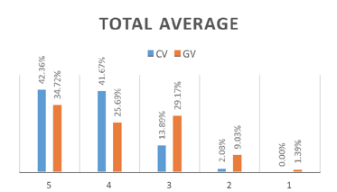
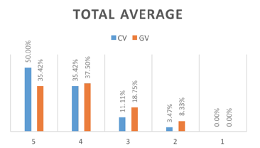
Questionnaire
T-test indicated significant differences for questions 5 and 7 on the vehicle & aircraft datasets, and the average score of all 3 datasets
Question 5: It was easy for me to identify the differences and similarities between the target and other objects
Question 7: The orientations (viewpoints) of the objects were informative
CV performs better than GV in these aspects on the more complex datasets
Average result of question 5
Average result of question 7
Notes:
Combined with the participants’ suggestions from the interview section, the reasons causing the difference in question 5 may be that:
The CV technique gathers similar objects within one screen and the most related objects are shown in similar sizes and colors. These features assist participants to narrow down their searching focus to the similar ones and easily compare them with the potential targets.
We also suggest that the reason for the difference in question 7 is that although the initial viewpoint is not ideally canonical in both techniques, it’s easier to observe the different viewpoints in CV technique since all objects can be rotated together, rather than only rotating one object once in GV technique.
While no significant results were found in the remaining questions, the CV technique also gain good scores on them.

Slide 31
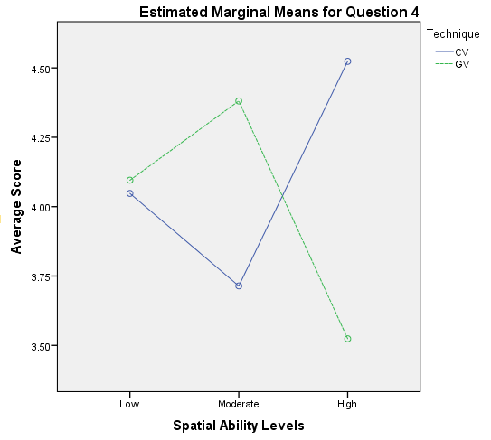
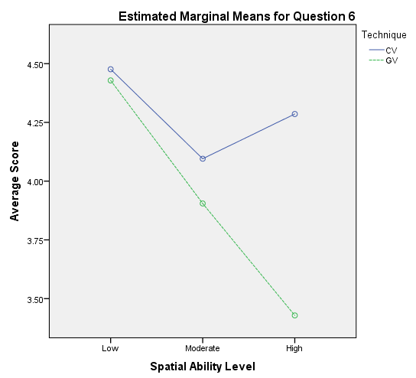
Questionnaire
We ran a two-way ANOVA over the participants’ spatial abilities and post-task questionnaire average scores on every question
“Easy to browse the models?”
Participants with moderate spatial ability favored GV
Participants with high spatial ability preferred CV
“The layout is ‘visually pleasing’?”
Preference for CV becomes stronger as the participants’ spatial ability levels increase
Notes:
The CV technique probably will be easy to be learned for the subjects who have better spatial ability.

Slide 32
Interview
Which system you prefer to browse the 3D-object dataset? | 56.25% of participants prefer CV 27.08% of participants prefers GV remaining participants (16.67%) preferred different techniques depending on the situation
Which technique do you think you finished tasks faster? | 58.3% participants think CV makes them more efficient 35.4% participants favor GV
Which technique you think is more interesting | 95.83% participants favor CV
Notes:
In the middle of this experiment, we thought it would be helpful to get an initial insight about their engagement by asking “Which technique you think is more interesting”. Among the later 24 participants, 23 of them suggested the CV technique is definitely more interesting, while only 1 participant thought it depends on the particular tasks.

Slide 33
User Study 2
Notes:
The second user study will be presented shorter, because it’s design is really similar with the first user study, and it just measures a side feature of our system.
It’s not a very general conclusion, it’s results only work for the very specific situation, and there are lots of parameters can be adjusted when studied with staggered animation. Which we didn’t research deeper on these influences.

Slide 34
Study Design
2 X 3 within-subject design
2 Types of Animations
SA (Staggered Animation) vs. NSA (Non-Staggered Animation)
3 Types of Datasets
Furniture, Vehicle and Aircraft
48 Participants (144 cases)
Dependent Variables
Accuracy
Error
Confidence level of decisions
Notes:
In this pilot study, the participants could not notice the differences of the transition while they’re mostly focusing on searching objects, even though they were told that they need to pay attention to the different types of transitions. Correspondingly, they provided similar scores for both types of animations, and suggested that they could only recall a vague memory of the differences.
The accuracy is defined as the number of participant’s correct choice divided by the total number of targets.
The accuracy metrics provide a good and simple view of the correctness rate of participants’ selections, but it does not reveal the distances between the selections and the targets. In our experiment, the selection which is far from the target should be penalized more than the one that
is close to the target. Hence, we used the error metrics that evaluate the distance from the selections to the correct answers.
the level of confidence is defined as the average confidence score of the participant’s decisions (including both correct and wrong decisions) within a task

Slide 35
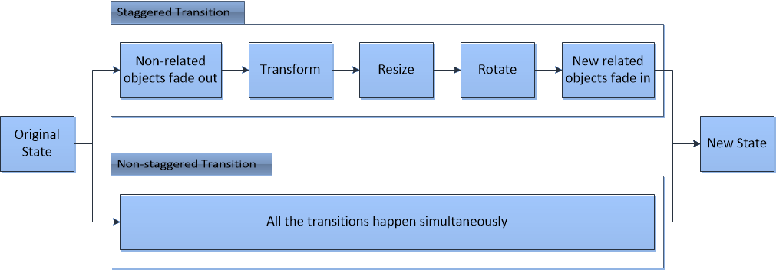
Animation Difference

Slide 36
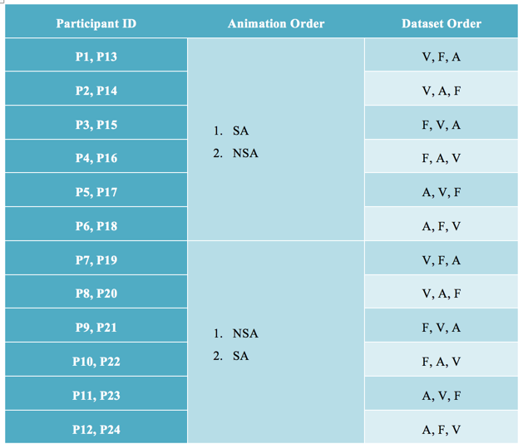
Task Arrangement

Slide 37
Study Result
Dependent Factors | Independent factors
 | Technique | Type of Datasets
Accuracy | N.S. | S.
Error | N.S. | S.
Level of Confidence | S. | S.
The interactions between the 2 independent variables were not significant.
Notes:
Overall, the types of datasets seemed to be the most influential factor. We speculate that this is due to the animation transitions not being good enough to assist the participants with tracking the objects, so that the participants had to rely on the objects’ geometric features. Although the
technique seems to be the less influential one, it does have some influence on the confidence level, and also there are some interesting trends showed over other dependent aspects.
The NSA provides a little higher score than the SA on both accuracy metrics and error metrics, and it even shows a significantly higher rating than SA on the level of confidence. This also validated some of the opinions given by the participants in the interview session that the NSA provides longer and slower transitions and seems to be a more natural approach.
There are many more parameters that might have an influence on the final result, including duration of the animation, rotation of each stage, the combination of stages, and the animation dwell time. In our case, we left the values of these parameters fixed. Further study will be needed
to obtain a better insight into animation design for 3D objects.

Slide 38
Conclusions & Discussions
Notes:
we summarize the thesis and highlight the contributions, limitations, and suggest potential directions for future work.

Slide 39
Contributions
Our system offers significant performance gains for searching time, especially when the 3D dataset has high similarity levels
Our system leads to fewer wrong choices, perhaps because it provides an easier way to compare similarities and differences between objects
Our novel system does not mislead subjects with a comparable confidence
Most subjects considered our approach to be more interesting for 3D browse and search
Most subjects suggested non-staggered animation offered a better way to observe transitions

Slide 40
Limitations & Future Works
We provide an occlusion-free layout in initial state, but overlaps can occur in the free rotation phase
Using shape as the only feature to organize objects seem to be good enough, but we think more features may narrow down the search
Add text searching
Jumping from one group to another very different group can be difficult and time-consuming
Further evaluations
Evaluate general searching
Evaluate the specific influential factors

Slide 41
References
Bateman, S., Gutwin, C., & Nacenta, M. (2008). Seeing Things in the Clouds: The Effect of Visual Features on Tag Cloud Selections. Proceedings of the nineteenth ACM conference on Hypertext and hypermedia. pp. 193-202. Pittsburgh, USA: ACM.
Blanz, V., Tarr, M. J., Bulthoff, H. H., & Vetter, T. (1995). What object attributes determine canonical views? Perception, Suppl., 24:199c.
Chen, D.-Y., Tian, X.-P., Shen, Y.-T., & Ouhyoung, M. (2003). On Visual Similarity Based 3D Model Retrieval. Computer Graphics Forum, 22, Number 3.
Chevalier, F., Dragicevic, P., & Franconeri, S. (2014). The Not-so-Staggering Effect of Staggered Animated Transitions. IEEE Transactions on Visualization and Computer Graphics, 1077-2626.
Clark, J. (2008). Clustered Word Clouds. Retrieved 2016, from Clustered Word Clouds (2008): http://www.neoformix.com/2008/ClusteredWordClouds.html
Dengsheng, Z., & Guojun Lu. (2002). An Integrated Approach to Shape Based Image Retrieval. Proc. of 5th Asian Conference on Computer Vision (ACCV), (pp. 652-657). Melbourne, Australia.
Dragicevic, P., Benzerianos, A., Javed, W., Elmqvist, N., & Fekete, J.-D. (2011). Temporal Distortion for Animated Transitions. CHI '11 Proceedings of the SIGCHI Conference on Human Factors in Computing Systems, (pp. 209-2018). Vancouver,BC,Canada.
Dutagaci, H., Cheung, C. P., & Godil, A. (2010). A Benchmark for Best View Selection of 3D Objects. 3DOR '10 Proceedings of the ACM workshop on 3D object retrieval (pp. 45-50). Firenze, Italy: ACM.
Feinberg, J. (2008, June 1). Wordle - Beautiful Word Clouds. Retrieved 2015, from Wordle - Beautiful Word Clouds: http://www.wordle.net/
Feinberg, J. (2010). Wordle. In J. Steele, & N. Iliinsky, Beautiful Visualization: Looking at Data through the Eyes of Experts (Vol. Chapter 3, pp. 37-58). Sebastopol: O'Reilly Media.
Funkhouser, T., Kazhdan, M., Shilane, P., Min, P., Kiefer, W., Tal, A., . . . Dobkin, D. (2004, Augest). Modeling by Example. ACM Transactions on Graphics (TOG) - Proceedings of ACM SIGGRAPH 2004 , 23(3), 652-663.
Funkhouser, T., Min, P., Kazhdan, M., Chen, J., Halderman, A., & Dobkin, D. (2003, January). A Search Engine for 3D Models. ACM Transactions on Graphics (TOG), 22(1), 83-105.
Group, P. S. (n.d.). Princeton Shape Benchmark. Retrieved 2015, from http://shape.cs.princeton.edu/benchmark/
Halvey, M., & Keane, M. T. (2007). An Assessment of Tag Presentation Techniques. Proceedings of the 16th international conference on World Wide Web. WWW '07, pp. 1313-1314 . Banff, Alberta, Canada: ACM.
Hausner, A. (2001). Simulating Decorative Mosaics. Proceedings of the 28th annual conference on Computer graphics and interactive techniques (pp. 573-580). Los Angeles, CA, USA: ACM.
Heer, J., & Robertson, G. G. (2007, November). Animation Transition in Statistical Data Graphics. IEEE Transactions on Visualization and Computer Graphics, 13(6), 1240-1247.
Hiller, S., Hellwig, H., & Deussen, O. (2003). Beyond Stippling - Methods for Distributing Objects on the Plane. Computer Graphics Forum 22, 22(3), 515-522.
iTween. (2014). ( Pixel Placement TM and LLC) Retrieved 2015, from http://itween.pixelplacement.com/index.php
J, C. (1988). Statistical power analysis for the behavioral sciences. Psychology Press.
Kim, J., & Pellacini, F. (2002, July). Jigsaw Image Mosaics. ACM Transactions on Graphics (TOG) - Proceedings of ACM SIGGRAPH 2002, 21(3), 657-664.
Lee, C. H., Varshney, A., & Jacobs, D. W. (2005, July). Mesh Saliency. ACM Transactions on Graphics (TOG) - Proceedings of ACM SIGGRAPH 2005, 24(3), 659-666.
Lloyd, S. P. (1982, March). Least squares quantization in PCM. IEEE Transactions on Information Theory, 28(2), 129-137.
Lohmann, S., Ziegler, J., & Tetzlaff, L. (2009). Comparison of Tag Cloud Layouts: Task-Related Performance and Visual Exploration. INTERACT '09 (pp. 392-404). Berlin, Heidelberg: Springer-Verlag.
Merrell, P., & Manocha, D. (2011). Model Synthesis: A General Procedural Modeling Algorithm. IEEE Transactions on Visualization and Computer Graphics. 17, pp. 715-728. IEEE.
Min, P. (1997). meahConv. Retrieved 2015, from http://www.patrickmin.com/meshconv/
Page, D. L., Koschan, A. F., Sukumar, S. R., Roui-Abidi, B., & Abidi, M. A. (2003). Shape Analysis Algorithm based on Information Theory. Image Processing, 2003. ICIP 2003. Proceedings. 2003 International Conference on. 1, pp. I - 229-32 vol.1. IEEE.
Polonsky, O., Patane, G., Biasotti, S., & Gotsman, C. (2005). What's in an Image? Towards the Computation of the "Best" View of an Object. The Visual Computer, (pp. 840-847).
Reinert, B., Ritschel, T., & Seidel, H.-P. (2013, November). Interactive by-example design of artistic packing layouts. ACM Transactions on Graphics (TOG) - Proceedings of ACM SIGGRAPH Asia 2013, 32(6), No. 218.
Rivadeneira, A. W., Gruen, D. M., Muller, M. J., & Millen, D. R. (2007). Getting Our Head in the Clouds: Toward Evaluation Studies of Tagclouds. CHI 2007 Proceedings, Tags, Tagging & Notetaking, pp. 995-998. San Jose, CA, USA.
Vazquez, P.-P., Feixas, M., Sbert, M., & Heidrich, W. (2001). Viewpoint Selection using Viewpoint Entropy. VMV '01 Proceedings of the Vision Modeling and Visualization Conference 2001, (pp. 273-280). Stuttgart, Germany.
Viegas, F. B., Wattenberg, M., & Feinberg, J. (2009). Participatory Visualization with Wordle. IEEE Transactions on Visualization and Computer Graphics. 15, pp. 1137 - 1144. IEEE.
Warehouse, 3. (2014). Homepage. (Trimble Navigation Limited) Retrieved 2016, from 3D Warehouse: https://3dwarehouse.sketchup.com/index.html
Wikipedia. (n.d.). Archimedean spiral. (Wikipedia) Retrieved Augest 2006, from https://en.wikipedia.org/wiki/Archimedean_spiral
Wikipedia. (n.d.). Tag cloud. Retrieved July 2016, from Wikipedia: https://en.wikipedia.org/wiki/Tag_cloud#cite_note-stateunion-24
Yee, K.-P., Fisher, D., Dhamjia, R., & Hearst, M. (2001). Animated Exploration of Dynamic Graphs with Radial Layout. Information Visualization, 2001. INFOVIS 2001. IEEE Symposium on (pp. 43-50). San Diego: IEEE.
Yobi3D. (2016). Search result of keyword "vehicle". Retrieved 2016, from Yobi: https://www.yobi3d.com/#!/search?q=vehicle
Yu, L.-F., Yeung, S.-K., Tang, C.-K., Terzopoulos, D., Chan, T. F., & Osher, S. J. (2011, July). Make it Home: Automatic Optimization of Furniture Arrangement. ACM Transactions on Graphics (TOG) - Proceedings of ACM SIGGRAPH 2011, 30(4), Article No. 86.

Slide 42
Thank you ! :)
Q & A

Slide 43
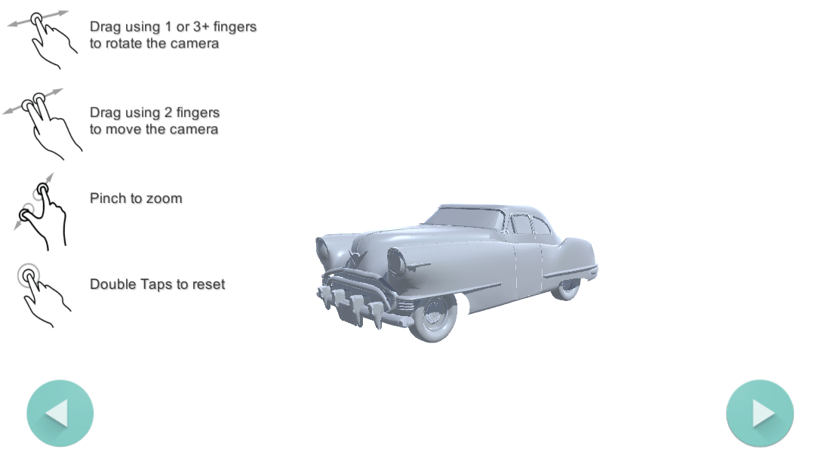
An example layout of the reference interface

